Slide 1
Rideshare App
Divyesh, Sai Chittela, Andrew, Akshay and Maanas

Slide 2
About the software
Exclusively for Virginia Tech
This app is only for VT students to request rides from their VT peers.
Community Inclusion
The app’s purpose is to connect students in this community to be able to help one another in a safe and efficient manner.
Point Currency System
Currency in the app will be in points, which can be earned by giving rides or these points may be purchased with real money (for users who do not have access to a vehicle).
The goal of this app is eliminate the use of payment for rides as consistent drivers will never need to pay for rides but instead utilize accumulated points

Slide 3

Features
Verify all users are VT students
Riders & drivers
Support Center
Payment issues, app usage issues, bug reporting
Trip issue center
Car issues (e.g. breakdowns)
Other issues (rider needs to cancel)
Safety center
Protection for both riders and drivers

Slide 4
Features
Drivers
Riders
Accept/decline ride requests
View rider info such as rating & destination
Cash out method
Earn points towards free rides with each successful trip
Expenses center
Gas, car cleanup, other issues
Request a ride + cost estimate
Cancel request as needed
Schedule future rides
Split fare with friends or other passengers
Leave rating for driver
Leave tip for driver
Payment processing method

Slide 5
Requirements
Functional
Account Management
Create/edit/delete profile & login/logout
User Authentication
Verify user is a student at VT
Payment
Transactions using points or monetary
Point Usage
Calculation of the points required based on distance of the trip
Ride Dispatching
Ability to accept and request trips
Non-Functional
Scalability
Application is responsive and supports all riders and drivers from VT
Security and Privacy
Application must ensure user privacy
Login functionality must be enabled only for authorized students
Performance & Maintenance
Quick response time and maintainable
Manage to provide necessary notifications to students

Slide 6
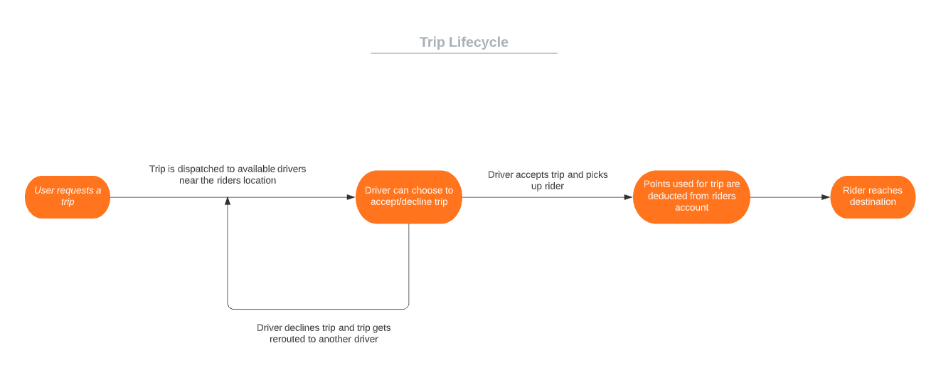
Application Flowchart

Slide 7
Questions?

